Slide 1


Slide 2
A Gentle Introduction to Bilateral Filtering and its Applications
Limitation?
Pierre Kornprobst (INRIA)
0:20

Slide 3

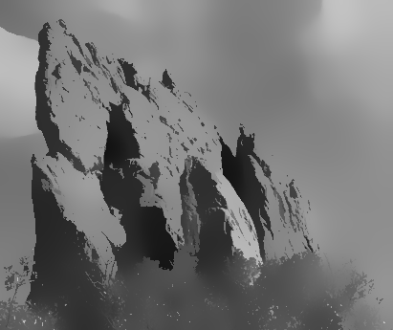
Examples
Soft texture is removed
Input
Bilateral filter

Slide 4



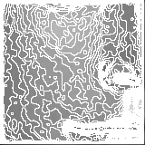
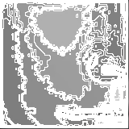
Examples
Constant regions appear
Input
Bilateral filter
[Buades, Coll, Morel, 2005]

Slide 5
Staircase effect
input
Bilateral filter tends to remove texture, create flat intensity regions and new contours
Questions
  Why does it occur?
  Can this be an advantage?
  Otherwise, can we solve this problem?
output

Slide 6
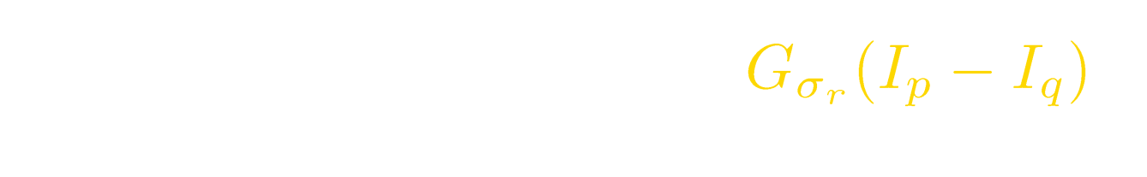




Why?
range
space
Bilateral filter is a weighted average of intensities and…

Slide 7


Why?
range
space
The number of points q satisfying I_{p}-h<I_{q}<I_{p} is larger than the number satisfying I_{p}<I_{q}<I_{p}+h.

Slide 8





Why?
range
space
Thus the average value is smaller than I_{p}, enhancing that part of the signal.
Note: Of course, opposite reasoning the the concave case

Slide 9


And Gaussians don’t change anything
range
space

Slide 10


And Gaussians don’t change anything
range
space

Slide 11




And Gaussians don’t change anything
range
space

Slide 12
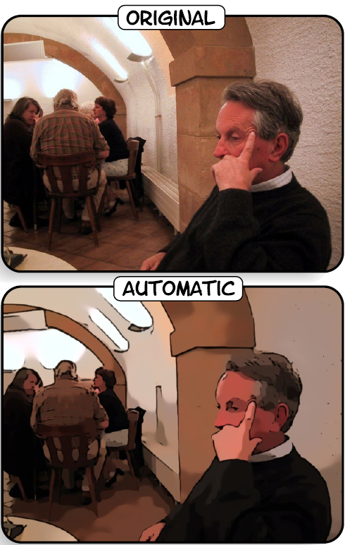
So… Can this be an advantage?
[Winnemöller, Olsen, Gooch, 2006]
Yes! Since we obtain cartoon-like pictures, let us do cartoons!...
Input
Output

Slide 13
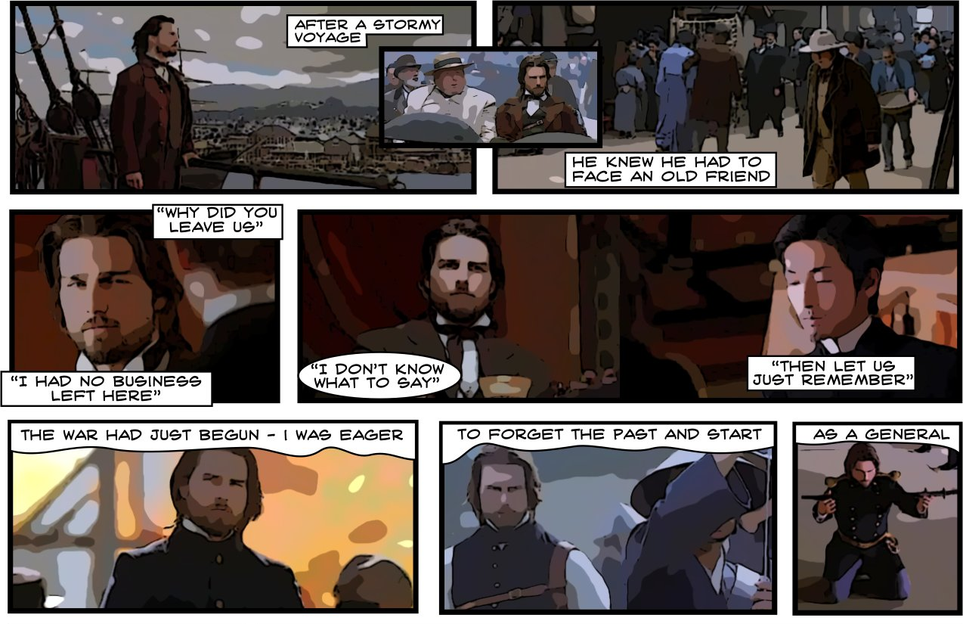
I said cartoons?
[Winnemöller, Olsen, Gooch, 2006]

